Slide 1
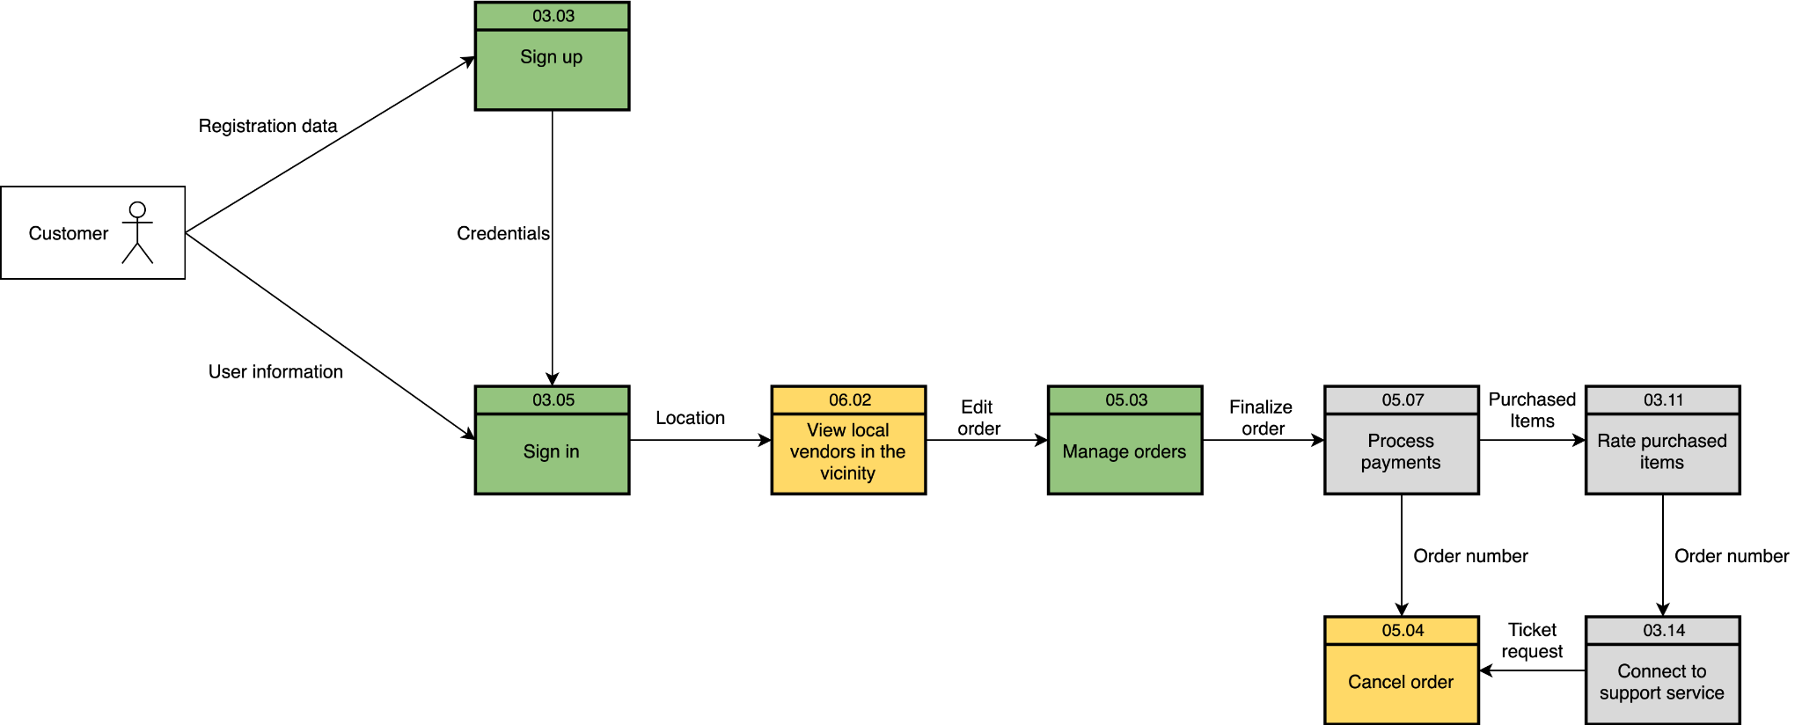
Carriage
Data Flow Diagram(Logical)

Slide 2
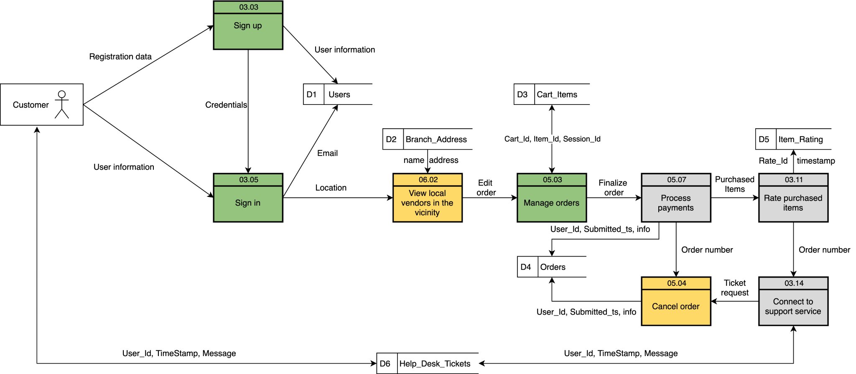
Carriage
Data Flow Diagram(Physical)

